Slide 1
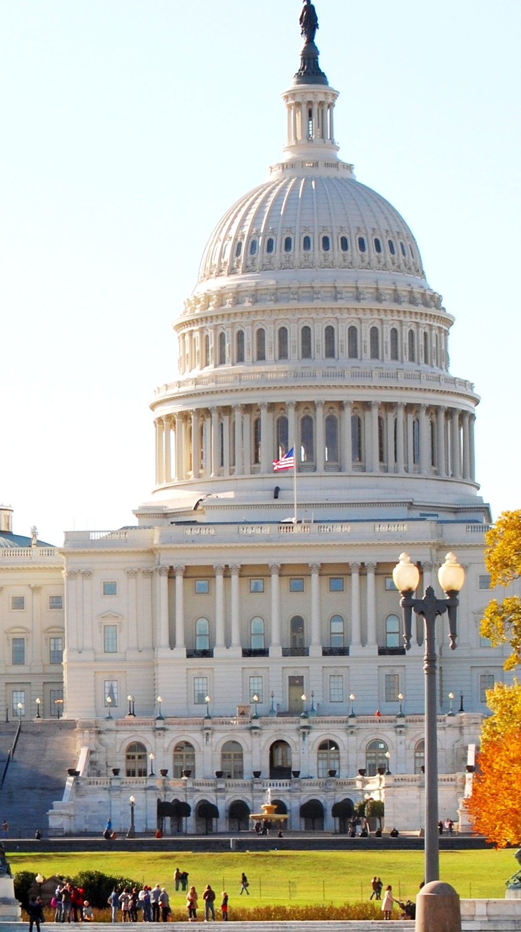
5-Year Renewal Webinar
Innovation & Economic Prosperity

Slide 2
Agenda
Announcements
Requirements
Application Review Process
GivePulse Software Tutorial
Q&A
Purpose

Slide 3
Announcements
IEP Annual Reflection Memos Deadline – April 1, 2024, 11:59 PM Pacific
IEP Awards Application Deadline – April 12, 2024, 11:59 PM Pacific
  Complete intent to apply form here
IEP Awards Reviewer Interest Form
IEP Communications Opt-In Form

Slide 4

5-Year Renewal Purpose
Reaffirm the institution’s commitment to economic engagement
Ensure Growth and Improvement Plan and economic engagement enterprise is consistent with current conditions and goals
Ensure IEP designation continues to serve as a mark of excellence that distinguishes IEP universities
Facilitates knowledge transfer due to leadership transitions
Notes:
Caydan

Slide 5
5-Year Renewal Requirements Overview
Gather Data
Develop a short (3 – 5 slide or 2-page) presentation or summary
Gather Stakeholder Feedback (3 internal & 3 external)
Fill out the Renewal Application and attach the presentation, summary, or other information presented to stakeholders

Slide 6

5-Year Renewal w/ new G&I Plan (2024)
GATHER DATA
DEVELOP SHORT PRESENTATION OR SUMMARY
3-5 SLIDES
2 PAGES
GATHER STAKEHOLDER FEEDBACK
Unlimited Internal
Unlimited External
Fill out the Renewal Application and attach the presentation, summary, or other information presented to stakeholders
Create a new Growth & improvement plan (3 areas of improvement identified during application process)

Slide 7

Application Sections
Notes:
Alvaro

Slide 8
Section 1: Synthesis of Key Shifts
If available, use the compiled five years of annual reflection memos to describe shifts in your regional economic engagement landscape since your initial IEP university designation application.
If you don’t have any of those available don’t worry. Just answer the questions as best you can
How do those developments trace back to your initial IEP designation work, if at all? What new opportunities or challenges does your ecosystem and institution face?
Notes:
This section is 400 words

Slide 9
Section 2: Description of Stakeholder Engagement and Changes to Growth & Improvement Plan
Describe key elements of your stakeholder engagement processes over the past five years and how you engaged stakeholders as part of preparing this application for the five-year Renewal.
Attach any materials, for example, agendas, PowerPoints, or handouts, that supported the engagement.
Describe who you engaged, how you engaged them, and how they responded.
How does the input you received affect the changes to your growth and improvement plan?
Notes:
This section is 300-400 words

Slide 10
Section 3: Participation in IEP Program
Describe highlights of your participation in the IEP program since designation.
What activities, meetings, webinars, or other activities have you participated in?
What improvement would you suggest for the program?
Notes:
~200-300 words

Slide 11
Section 4: Overall Assessment of 5 Years as IEP University
Describe the key benefits you have derived from earning the IEP designation and participating in the IEP program.
Explain why you are interested in extending the designation and continuing to participate.
Notes:
~200-300 words

Slide 12
Section 5: Growth & Improvement Plan (if at 10-year mark)
Please describe three areas of improvement or opportunity identified via the IEP Renewal process and how you plan to address them.
Your description for each should be area should be about 500 words.
Your growth/improvement plan should be a total of about 1500 to 2000 words, NOT including the summary table
Notes:
~200-300 words

Slide 13
Application Review Process
Notes:
Alvaro

Slide 14
Application Review Process
Potential Reviewer Recommendation
  Institution should be granted the five-year Renewal
  Institution should be granted a provisional Renewal. Areas that they should address include the following…
Two reviewers per application
In the event of a split decision, a member of the IEP Advisory Committee will review the application and provide a recommendation

Slide 15
Post-Review Process
After successfully passing the 5-year designation Renewal, the IEP institution will commit at least one, preferably both, of their campus contacts, to serve as a reviewer for designation, awards, or Renewal, at least three times over the following three years.

Slide 16



5-Year Renewal Application Scenarios
If an institution submits a 5-Year Renewal but the application is not approved – must revise the application and submit it again in 6 months
If an institution does not submit a 5-Year Renewal application – the institution must complete a 5-Year Renewal application with a new G&I Plan within 12 months to maintain IEP Designation
If the institution does not submit a 5-year Renewal with a new G&I Plan within 12 months and does not continue engaging in IEP – IEP Designation lapses
The institution is moved to “Inactive Status”
Institution must submit a new IEP designation application to reinstate IEP membership

Slide 17
2024 IEP 5-Year Renewal Application Deadline
Friday, December 6, 2024, at 11:59 PM Pacific
Reminder: The full list of IEP 5-Year Renewal Application deadlines is here.
  *5-Year Renewal with New Growth & Improvement Plan application is launching in 2024 for select institutions

Slide 18
GivePulse Software Tutorial
Notes:
Alvaro

Slide 19
GivePulse, IEP Software
Access link
Pamphlet linked here
Training recordings linked here
Notes:
Caydan

Slide 20
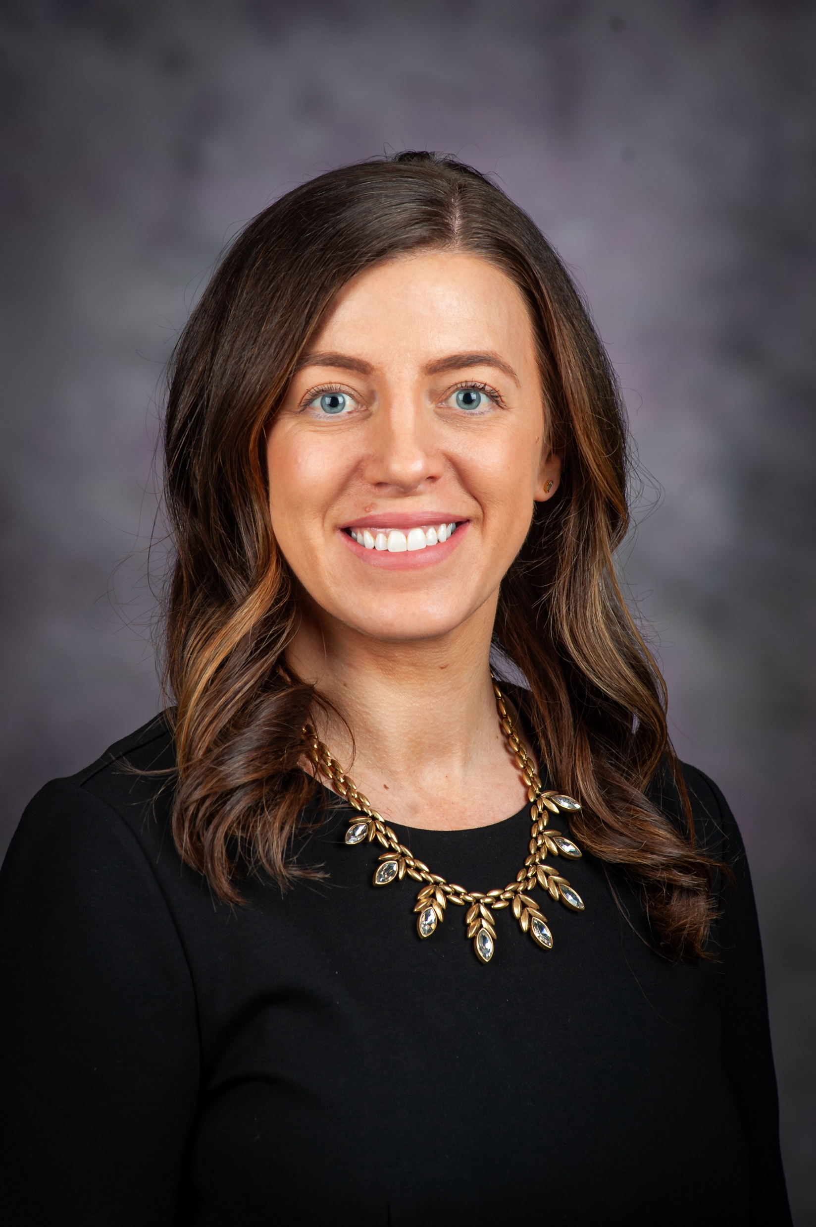

Featured Speaker
Rebecca Robinson
President & CEO
K-State Innovation Partners

Slide 21
Innovation and Economic Prosperity Designation
5-Year Renewal Experience

Slide 22

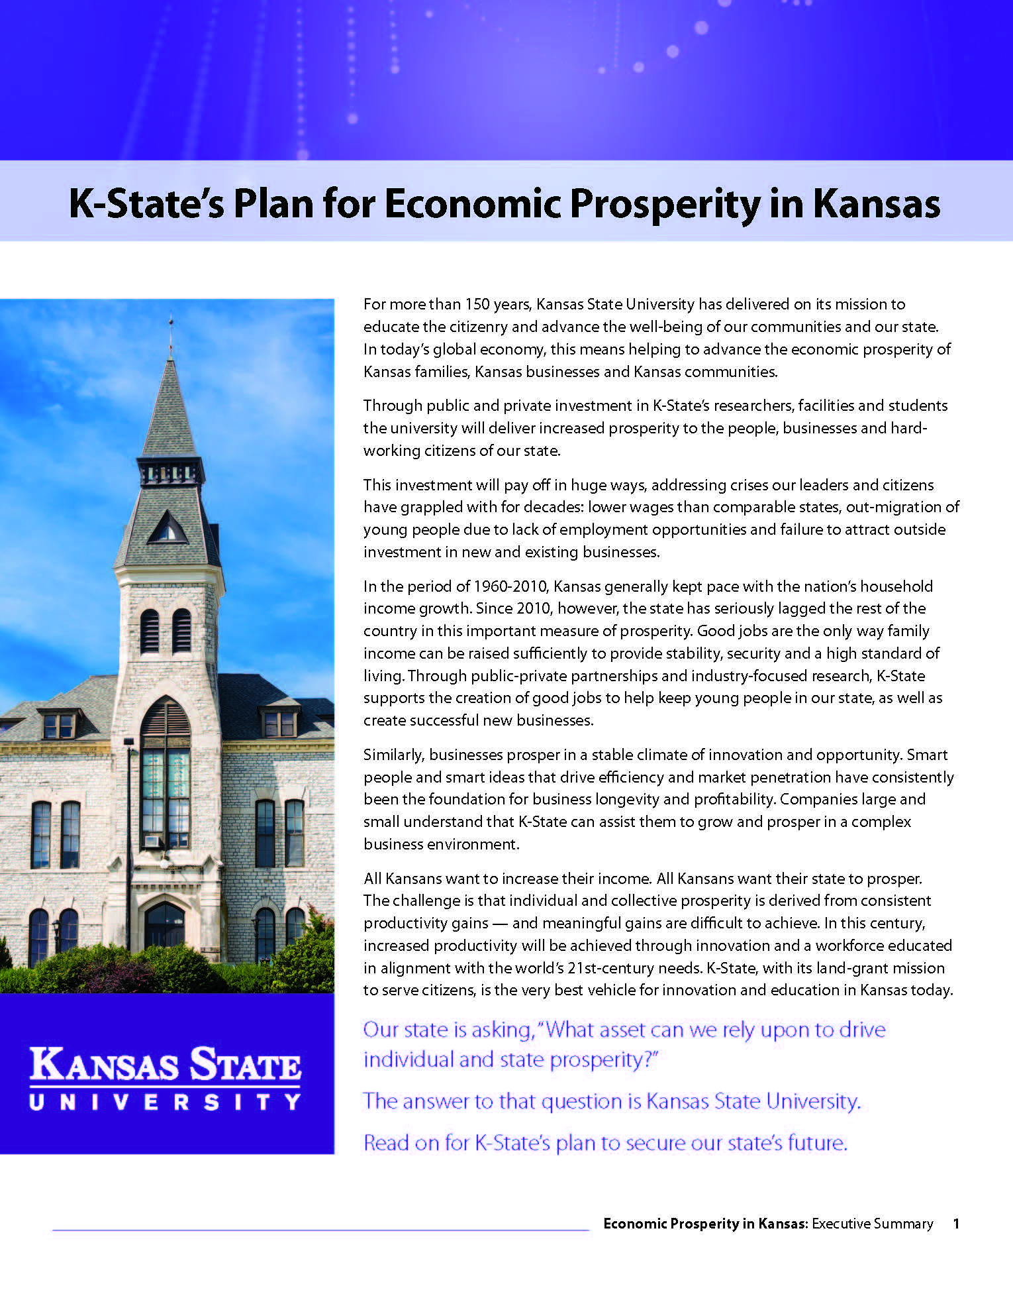
Getting started
Ensure institutional leadership support
Create small core Renewal team
Orient staff to IEP designation submission materials, G&I plan
Compile existing reports, data, strategic plans that support Renewal
Put files in a place that can be shared by staff (eg. MS Teams, Google Docs, Box, etc…)

Slide 23
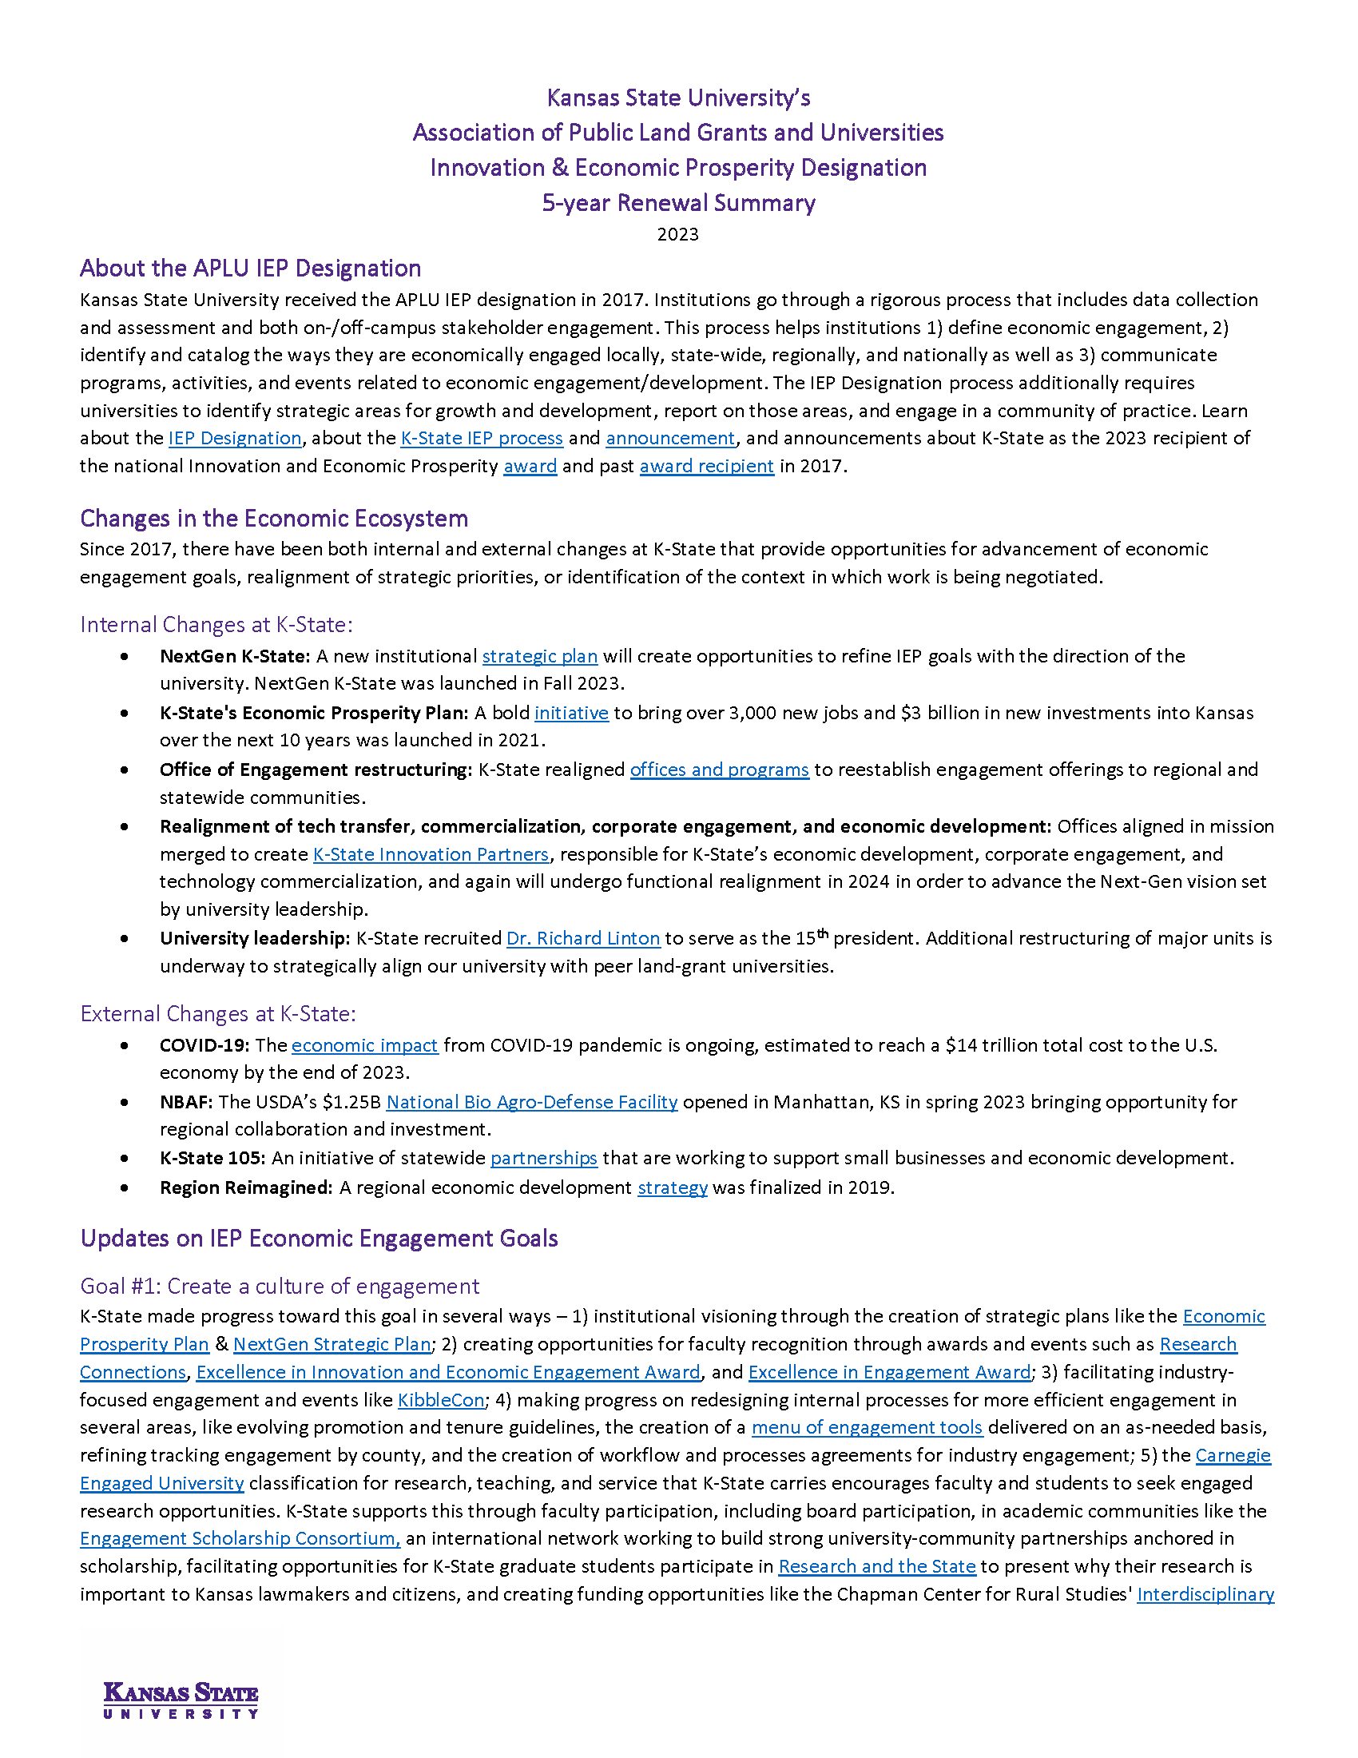
Engaging Stakeholders
Engage institutional knowledge to outline key shifts, changes to G&I plan, & participation in IEP program
Remind/inform stakeholders of the designation, purpose, and history

Slide 24
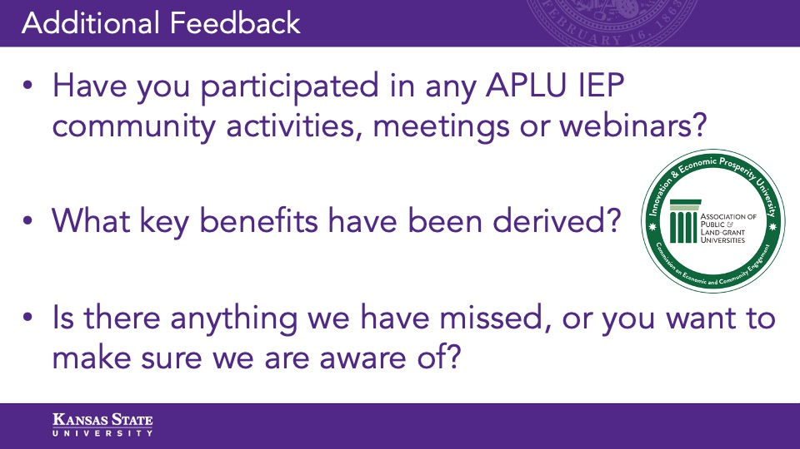
Maximizing the value of stakeholder engagement
Provide outlines/drafts and ask for specific feedback & additions
Make it easy for stakeholders to engage, provide feedback

Slide 25
Stakeholder Engagement Example
Stakeholder presentations:
  Strategic Partner Planning Group: 38+ stakeholders involved in university-industry collaboration
  Associate Deans for Research Council: (4) engaged high level academic administrators
  Original Innovation and Economic Prosperity Designation steering committee (5) representatives
  Knowledge-Based Economic Development team: community economic development reps (6)
In each of these convenings, K-State shared a presentation and summary of changes to the ecosystem, progress that K-State has made to accomplishing G&I goals and facilitated conversation.
Stakeholders engaged in robust discussion, sharing additional progress over the last five years, validation of data, and ideas for how to adjust the G&I Plan.

Slide 26

Proposed changes to Growth and Improvement Plan
Identified Big Ideas and Key Priorities in NextGen K-State, K-State’s Economic Prosperity and the Kansas Framework for Growth that align with IEP activities
Compared to current Growth and Improvement Plan
Created additional activities to include in Growth and Improvement Plan to align with NextGen K-State
Adjusted language of current Growth and Improvement Plan to create synergistic plan

Slide 27
Next 5-Year Renewal & New G&I Plan Creation
Broader stakeholder engagement
  Town Halls
  Surveys
Reconvene IEP Steering Committee to guide the process
Scrutinize G&I plans

Slide 28
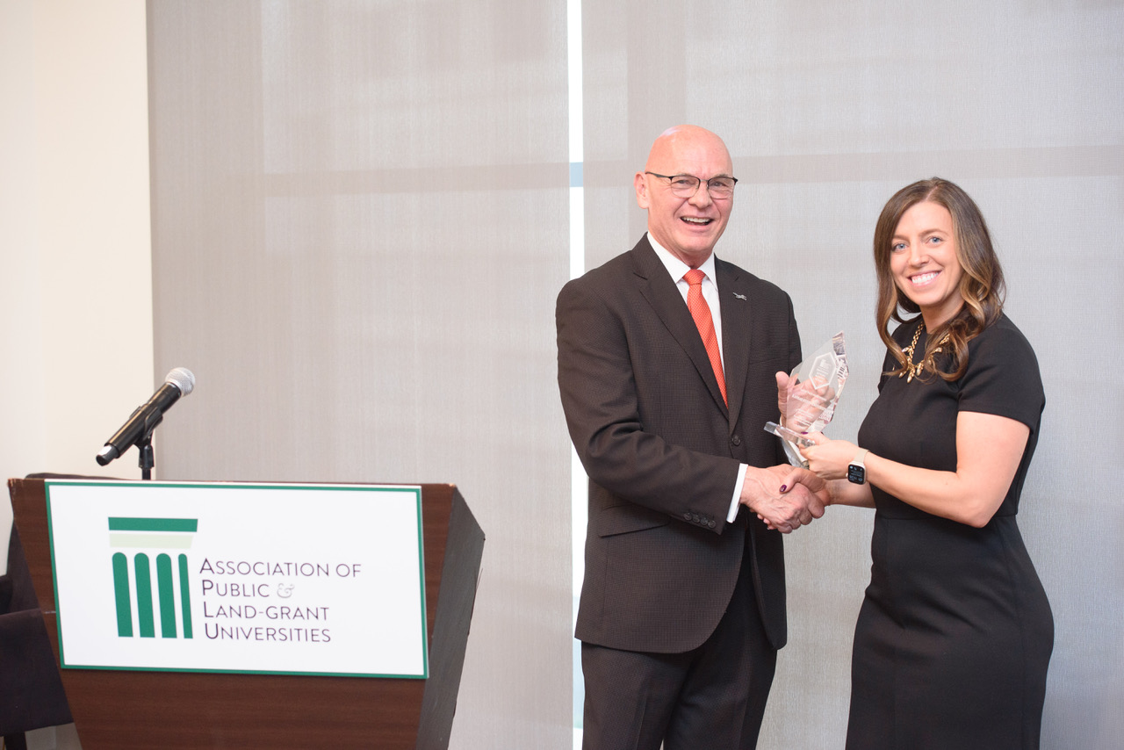
Other Tips
Maintain shared files and give access to multiple internal stakeholders to ensure continuity
Create annual records/memos – especially for information like IEP community engagement
Communicate and celebrate successes

Slide 29
Questions?
Rebecca Robinson
President & CEO
K-State Innovation Partners
785-532-3955
spexarth@ksu.edu

Slide 30
Additional Resources
5-Year Renewal Process Information (Link)
5-Year Renewal Practice Application (Link)
5-Year Renewal with New Growth & Improvement Plan Practice Application (Link)
5-Year Renewal Deadline Schedule (Link)
5-Year Renewal FAQ (Link)
Prospective 5-Year Renewal Stakeholder Engagement List (Link)

Slide 31
Contact Information
APLU IEP Email – iep@aplu.org
Alvaro Muñiz – amuniz@aplu.org
  202-478-6044
Caydan Henslee – chenslee@aplu.org
  202-478-6055

